Slide 1
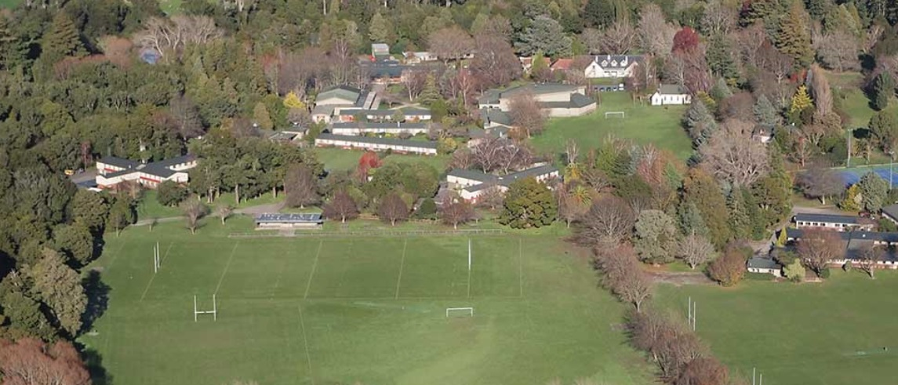
2024 DECADE REUNIONS
Leavers from: 1974, 1984, 1994, 2004, 2014.
King’s Birthday Weekend
Friday 31st May – Saturday 1st June 2024
PRIDE IN BELONGING

Slide 2
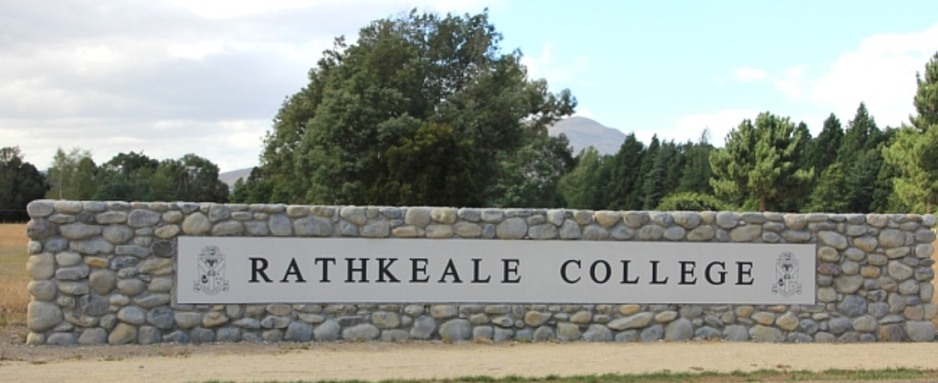
Rathkeale College Old Boys’ Association
Patron: John S Taylor
President: Edward Cox
Secretary: Tristan Armitage

Slide 3

WELCOME
Decade Reunions
The Executive of the Old Boys’ Association is very pleased to publicise next year’s Decade Reunions for all those year groups who departed the College in a “4” year.
Recent Reunions have left us with no doubt that such events are an important addition to the Association’s activities.
We very much hope that you and your contemporaries do all you can to ensure that your reunion is a wonderful one.
Individual year groups may choose their own activities and work in with Old Girls from St. Matthew’s or follow the proposed programme.
Please mark it in your diaries (Friday 31st May – Saturday 1st June 2024) and resolve to come along.

Slide 4
THE PROPOSED PROGRAMME
FRIDAY 31st May 6:30 PM – 10 PM
SATURDAY 1st June
Combined Old Boys’ and Old Girls’ Year Groups gathering, College Dining Hall.
An opportunity to mix and mingle with all those attending the weekend. College staff will be invited to attend. There will be brief speeches of welcome early in the evening. Park in the main carpark between School House and the Dining Hall.
A bus service may be provided
Cost is $25.00 per head. Payment is expected upon entry either by EFTPOS or correct cash amount.
Alcoholic and non-alcoholic drinks, finger food and a light supper will be provided.
9:00 AM Chapel for Absent Friends for Old Boys in St Martin’s Chapel at Rathkeale. Conducted by School Chaplain Ben Arcus. It would be great to have this well attended. Wives etc., are always welcome
10:00 AM Morning tea in the Dining Hall.
10:40 AM Official photographs – these will be taken in front of School House in keeping with tradition! Please be punctual so that these can be completed promptly. Copies of Photographs maybe ordered.
11:30 AM Tours of the College and a chance for you to poke your noses into your old haunts.
1:00 PM Light lunch in the Dining Hall courtesy of the College.
1:30 PM St. Matthews’ girls lunch followed by School tour.
Year Group Facilitators will structure the remainder of the day and arrange the venue for the evening’s dinner and activity.

Slide 5
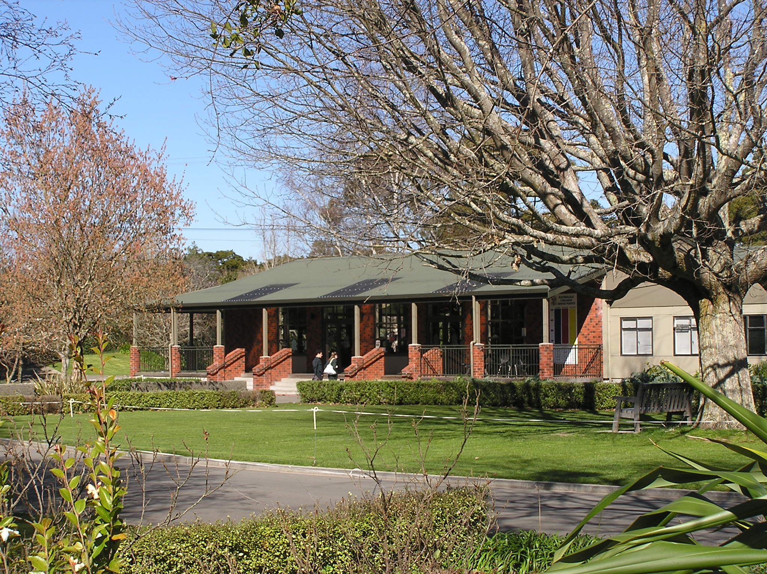
THANK YOU!
Rathkeale Old Boys’ Assn. Committee
Phone:
06 370 0175 ext. 7730
Email:
oldboys@rathkealeoldboys.org.nz

